Slide 1
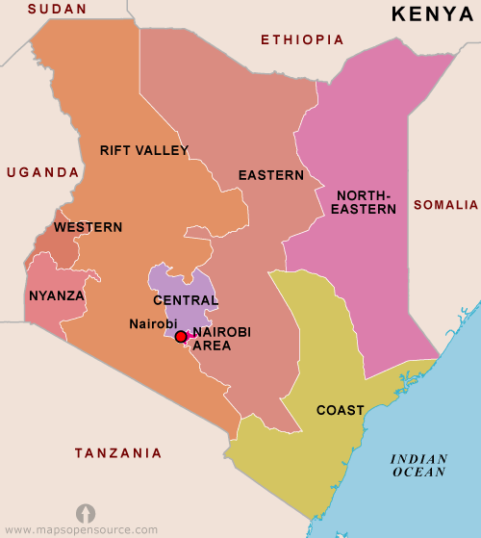
Laboratory African Regional Improvement Collaborative (LARC) A Quality Improvement Collaborative
Kenya Stakeholder’s Dissemination Meeting
Nairobi, Kenya
July 16, 2019
Patricia Riley, RN, CNM, FAAN, FACNM

Slide 2
LARC Background
While improvements have been made in HIV viral load (VL) testing, full integration of VL testing and related patient management has not been fully realized
Continuous Quality Improvement (CQI) has been introduced at the lab and clinic level, but the question remains:
Are laboratory professionals and clinicians effectively functioning as a team or in silos?
To what extent are mid-level professionals who provide ART services aware of the importance of VL testing and ensuring that these tests are:
Appropriately initiated
Specimens appropriately collected and labeled, or that
VL test results are sought and used in patient management

Slide 3
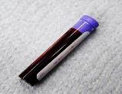
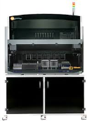
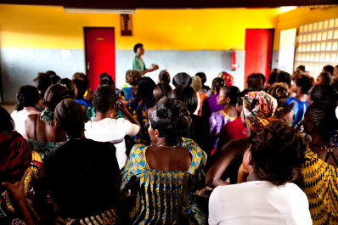
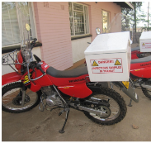
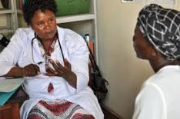
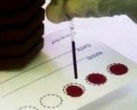
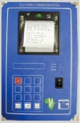
LARC interventions
The Viral Load Cascade
Bringing together the laboratory and clinical cadres to implement and scale up HIV viral load testing
Demand Creation for Testing
Specimen Collection & Processing
Sample Transport
Laboratory Testing
Result Reporting & Interpretation by Clinician
Patient Management
Notes:
The proven collaborative model PLUS the proven QI tools – brought to bear on HIV viral load testing

Slide 4
LARC Operational Framework
LARC’s goal:
Achieve and maintain HIV VL suppression by improving the uptake of VL testing through enhanced health systems and facility capacity – emphasizing inter-cadre functioning (lab-clinic interface)
Introduce an improvement culture whereby team members understand and routinely utilize Quality Improvement and Health Systems tools
LARC's specific objective:
Advance the understanding and awareness of HIV VL processes within health facilities
Create awareness of facility-level bottlenecks that impact VL scale-up
Enable local inter-cadre teams to remediate system barriers by introducing training in health systems approaches [e.g., Business Process Mapping (BPM), Capability Maturity Matrix (CMM), and various CQI analytic tools]

Slide 5
LARC 1.0 May 2017 – May 2018 Project Overview
Demand
creation
Sample collection/
transport
Laboratory
testing
Result
reporting
Patient
management
A learning collaborative using a proven CQI methodology to strengthen laboratory-clinic interface in support of VL scale-up
Viral Load Cascade
Mozambique
Malawi
Kenya
Swaziland
Tanzania
Uganda
↑ VL tests ordered for eligible patients
↑ VL samples collected from eligible patients
↑ VL results placed in patient files
↑ Patients with high VL called for return visit
↑ Patients with high VL who returned for 1st EAC

Slide 6
To increase the percentage of viral load samples collected from eligible patients from 45% (Jul 2016) to 80% by Aug 2017
To increase the percentage of viral load tests ordered for eligible patients from 0% (July 2016) to 80% by June 2017 in CPN, CCR, and ARV clinics
To increase the percentage of patients with viral load results placed in their files from 4% (October 2016) to 80% by June 2017
Mozambique
Malawi
Kenya
LARC Project
spread to
all Clinic
Clinician Education
All Clinic
Clinic Director Follow-up
Clinician Education began
Nationwide HCW strike
To increase the percentage of high viral load patients with documented timely follow-up from 12% (average from Dec’15 to June ‘16) to 80% by June 2017
To increase the percentage of high VL patients with a documented return visit from 35% (Oct 2016) to 100% by June 2017
To increase the percentage of high VL patients 1) contacted ≤ 1 week after results receipt from 27% to 90%, and 2) initiated with IAC ≤ 1 month from 6% to 90% between June 2016 and June 2017
Swaziland
Tanzania
Uganda
Baseline
HVL register implemented
IAC forms implemented
HVL stickers on patient files

Slide 7
LARC 2.0 in Kenya
Retained elements from LARC 1.0
But added new features
Learning Collaborative Model
Facility Teams learn from each other
Implementation:
Learning Sessions followed by Action Periods
Lab/Clinic Interface Focus
‘Viral Load Cascade’ Focus
New Curriculum
On-line CQI-health systems courses provided
New PowerPoint Presentation, introduced additional tools
Created a LARC Workbook (Tool Resource)
Delivery Model
Shorter Timeframe (6/2018-3/2019)
Pre-training Preparation – Webinars
New On-Site Session
Accountability/Follow-Up
Focus on Scalability
IP Training
Developed two models of implementation (DAS and RAS)

Slide 8
KENYA LARC 2018-2019 Timeline
Introduction Webinar
Smart Start (on site)
Session I
Session II
Session III
Final Report
Project Implementation Period = 10 Months
Jun ‘18
Aug 20-24 ‘18
Aug 27-29 ‘18
Feb ‘19
END:
Mar 2019
Nov ‘18
Project Outline
Action Period
Action Period
Action Period
Report
Completion
Preparation
Notes:
Still the collaborative model – learning sessions and action periods, but Shortened

Slide 9
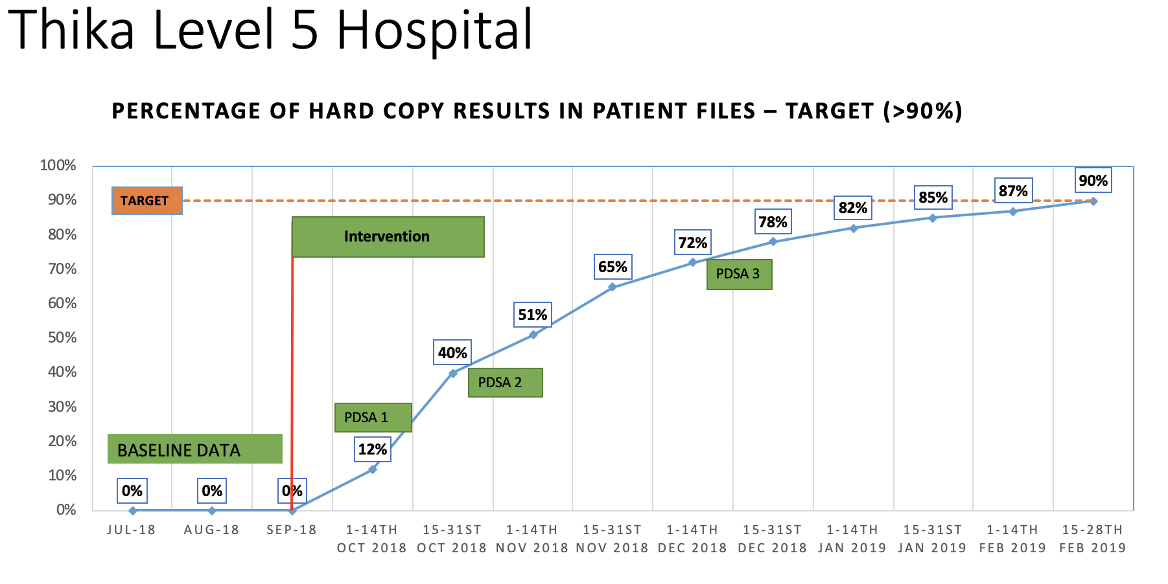
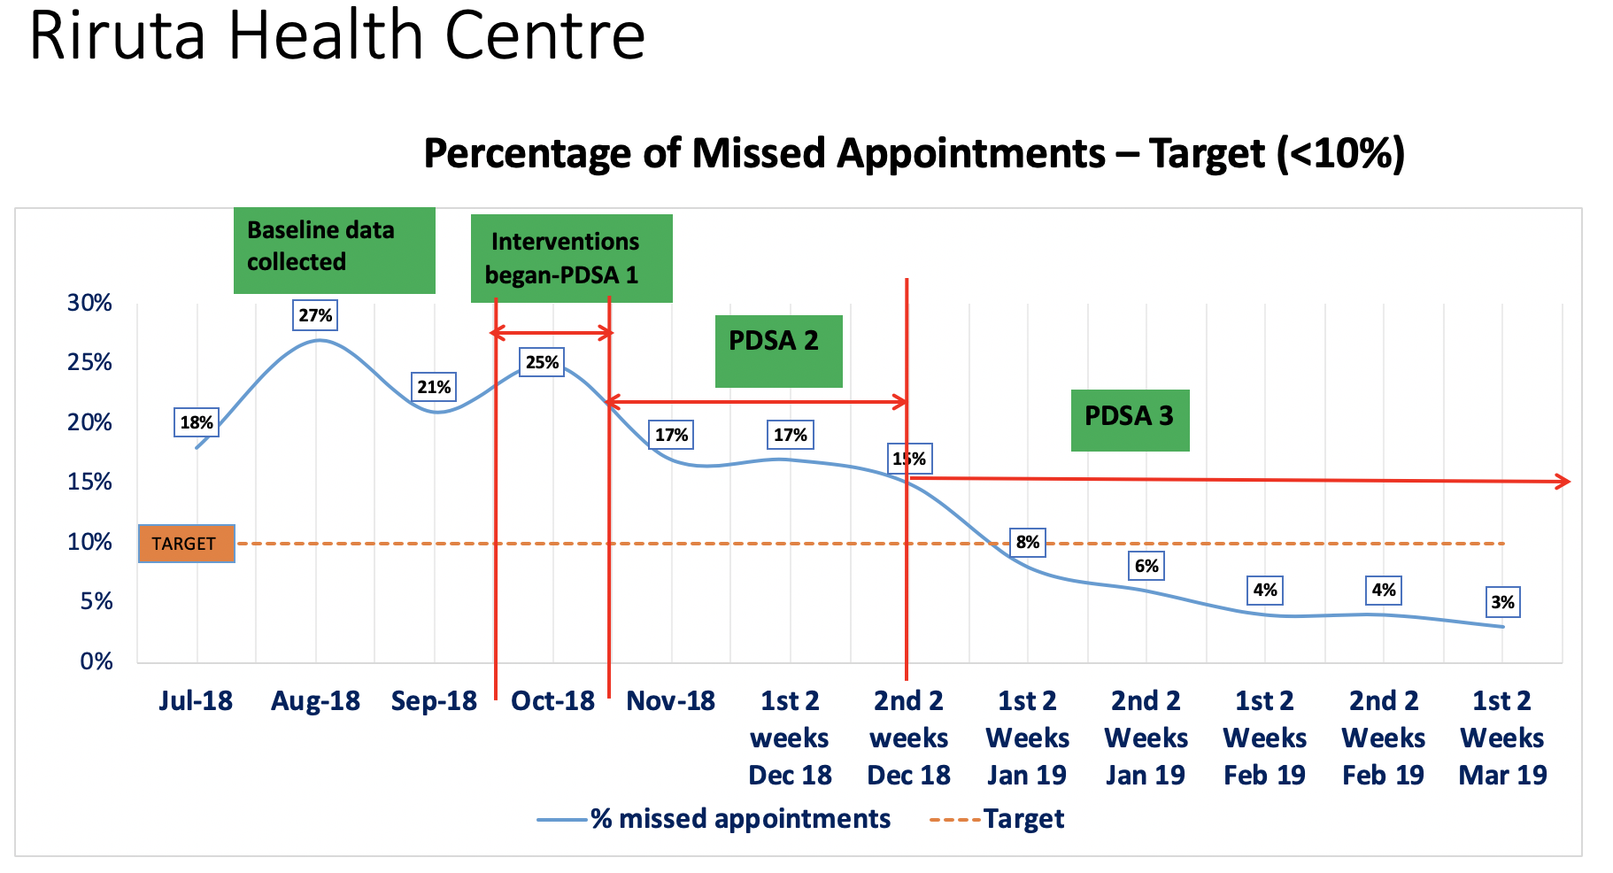
Results Direct Assistance UMB Sites (5)

Slide 10
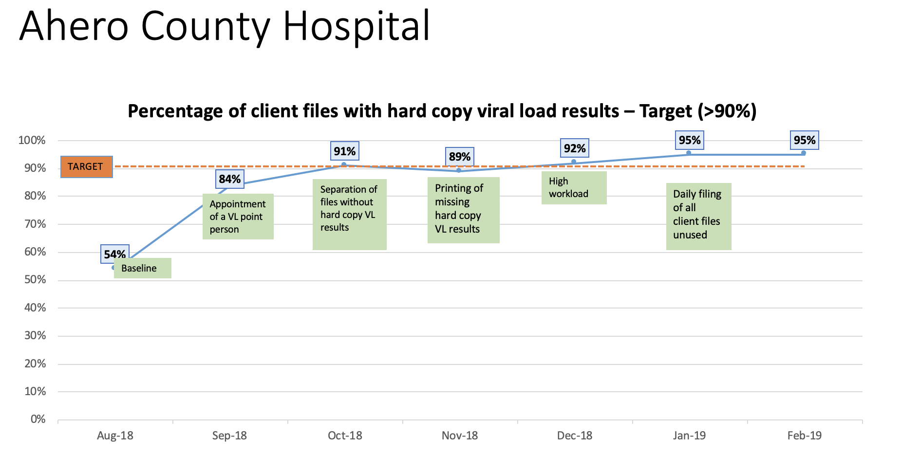
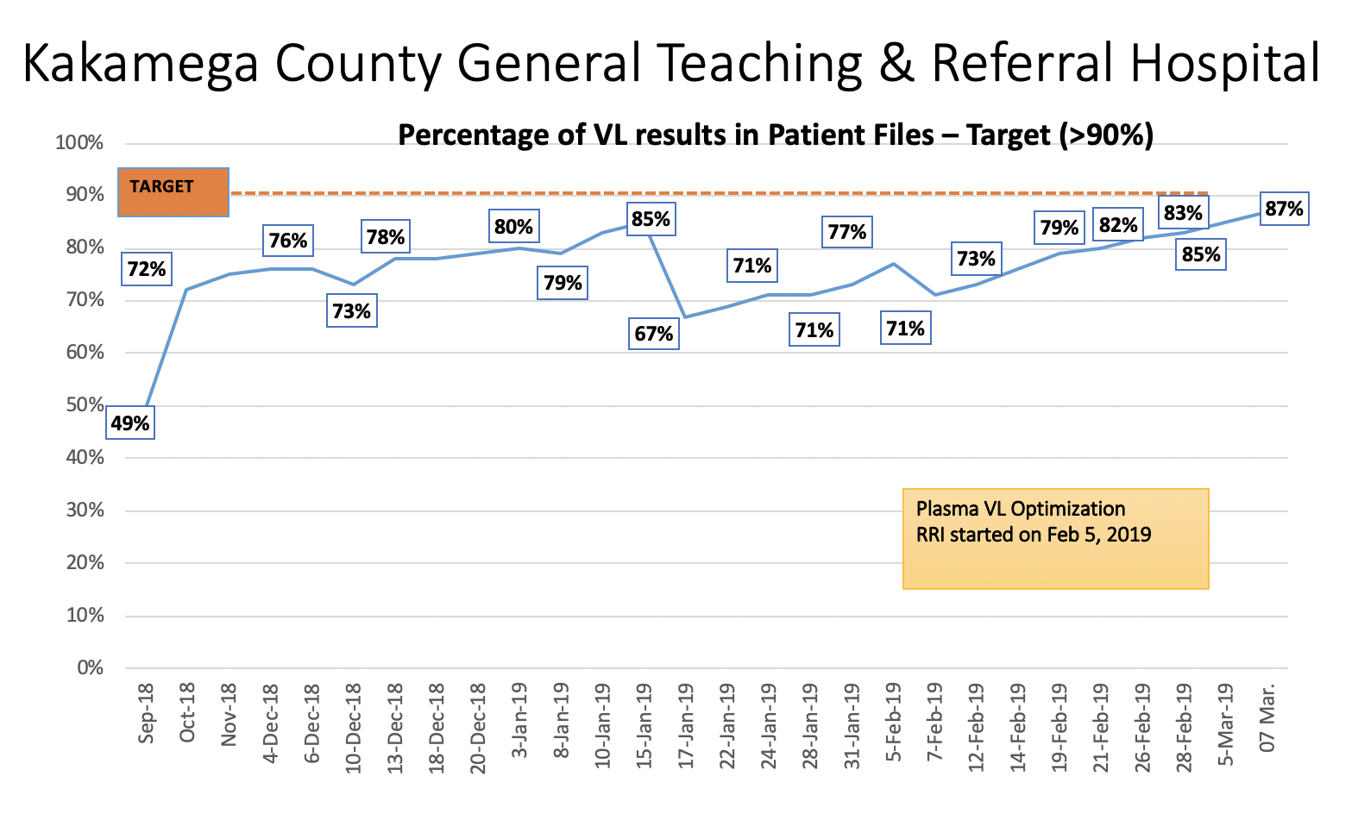
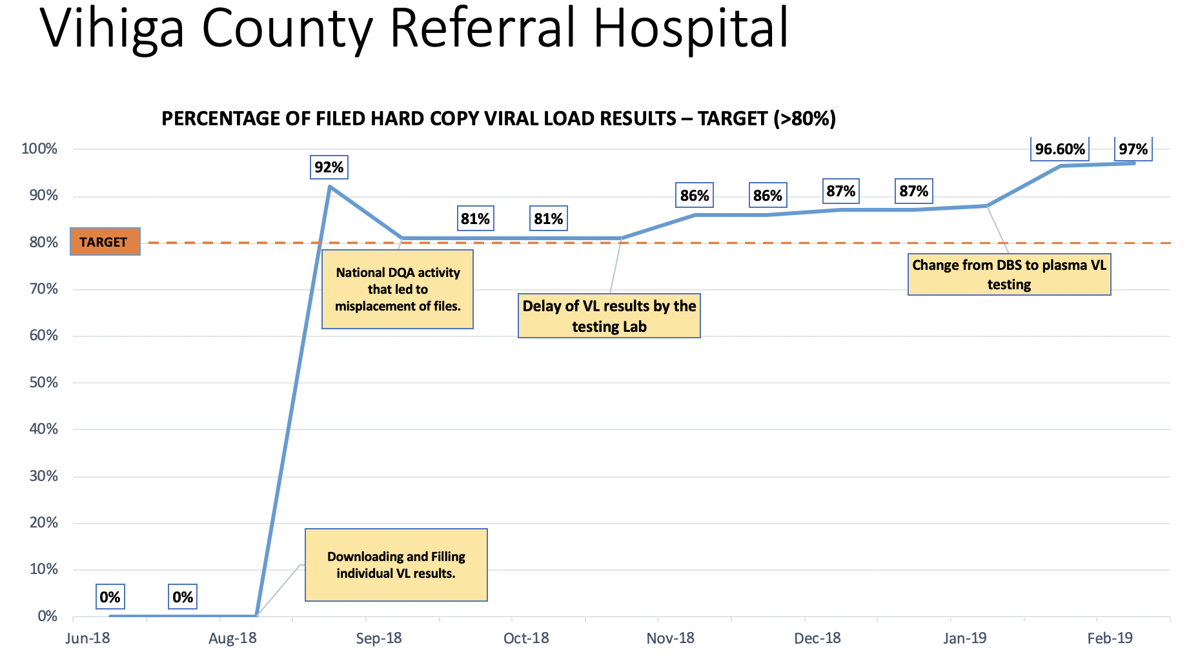
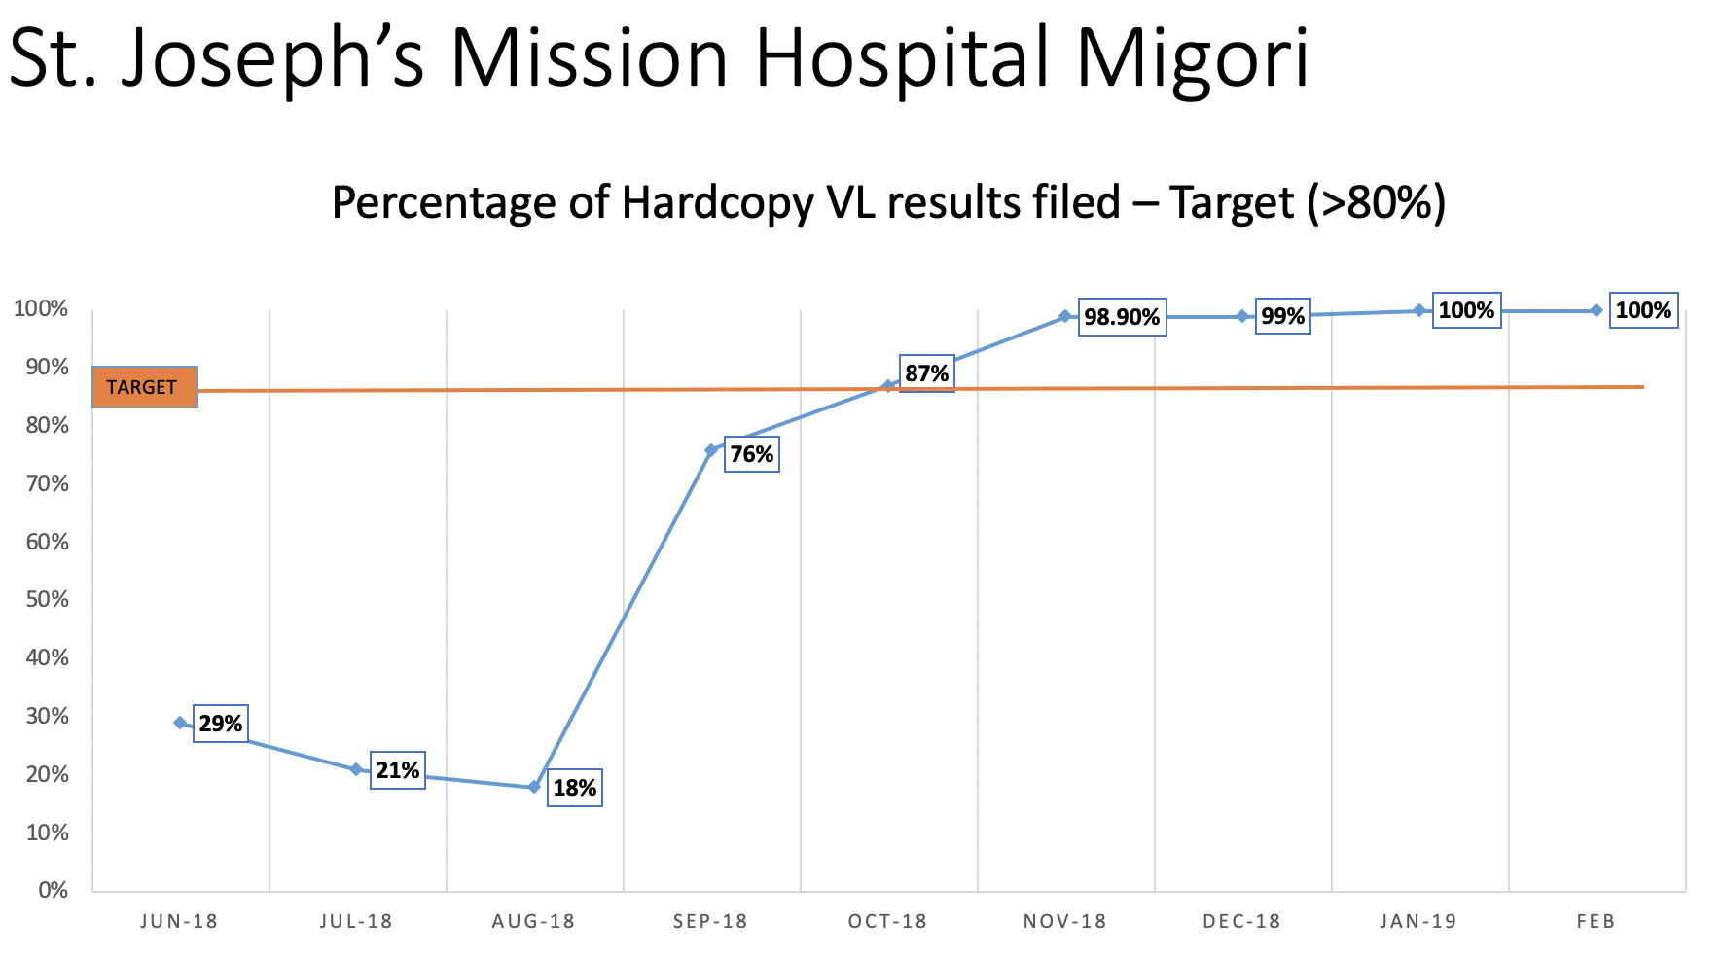
Six Remote Assistance Sites: Amref (1), FHI-360 (1), GIS (4)

Slide 11
LARC Project Dissemination per Project Protocol
Process Reports:
Intermediate reports informed LARC progress during the project period
Evaluation Report:
Within 90 days of project completion, a final project report will be made available to Kenya’s County and National Ministry of Health officials and other key (by September 2019)
Can provide insight for how to improve HIV service delivery
Peer-reviewed publications:
Joint authorship (Kenyan & US scientists) on paper planned for publication in professional journal
Presentations:
National and international research/professional conferences and meetings related to PEPFAR, HIV services, and Health Systems Improvement

Slide 12
The “life cycle” of an improvement project contains four distinct phases:* * IHI Course 105: Leading Quality Improvement
Innovation — coming up with new ideas for change | Pilot — testing a change on a small scale | Implementation — making the change the new standard process in a defined setting | Spread — implementing the change in several settings

Slide 13
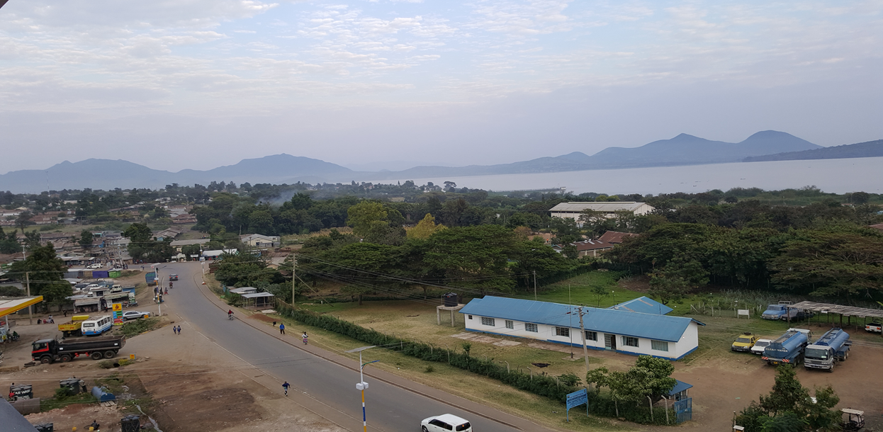
“HUDUMA-BORA NI HAKI YAKO”
IT IS YOUR RIGHT TO RECEIVE EFFICIENT SERVICES
“Asante Sana”
Thank You!

